Slide 1
Spatial filtering for Smoothing
For blurring/noise reduction;
Blurring is usually used in preprocessing steps,
e.g., to remove small details from an image prior to object extraction, or to bridge small gaps in lines or curves
Equivalent to Low-pass filtering in frequency domain because smaller (high frequency) details are removed based on neighborhood averaging (averaging filters)
Implementation: simplest form: averaging with a square mask (assume m×m mask) with the all coefficients equal to 1/m² (averaging).
Applications: Reduce noise; smooth false contours
Side effect: Edge blurring
CUI, Lahore Campus -- CSC 331: Digital Image Processing -- © Dr. Usama Ijaz Bajwa

Slide 2

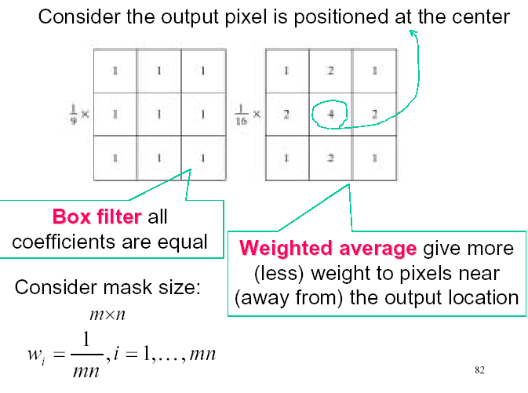
Smoothing filters
CUI, Lahore Campus -- CSC 331: Digital Image Processing -- © Dr. Usama Ijaz Bajwa

Slide 3

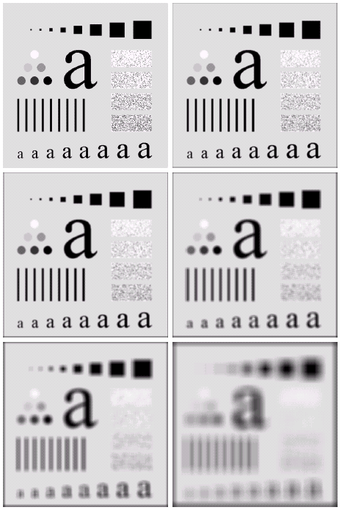

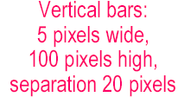


Spatial filtering for Smoothing (example)
CUI, Lahore Campus -- CSC 331: Digital Image Processing -- © Dr. Usama Ijaz Bajwa

Slide 4
Spatial filtering for Smoothing (example)
Original image size: 500 x 500
Smoothed by 3 x 3 box filter
Smoothed by 5 x 5 box filter
Smoothed by 9 x 9 box filter
Smoothed by 15 x 15 box filter
Smoothed by 35 x 35 box filter
CUI, Lahore Campus -- CSC 331: Digital Image Processing -- © Dr. Usama Ijaz Bajwa

Slide 5
Order-statistics filtering
Nonlinear spatial filters
Output is based on order of gray levels in mask (subimage)
Examples: Median filtering, Max & Min filtering
Median filtering
Assigns the mid value of all the gray levels in the mask to the center of mask;
Particularly effective when
  noise pattern consists of strong, spiky components (impulse noise, salt-and-pepper
  edges are to be preserved
  Force pixels with distinct gray levels to be more like their neighbors
CUI, Lahore Campus -- CSC 331: Digital Image Processing -- © Dr. Usama Ijaz Bajwa

Slide 6
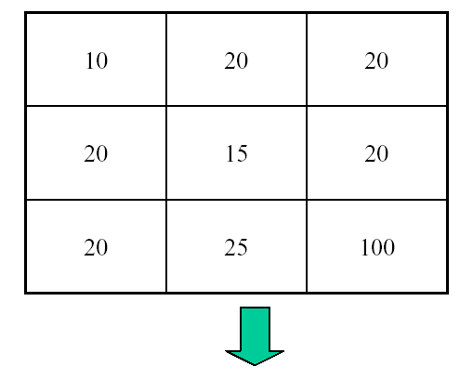
Median Filtering
Output ?
CUI, Lahore Campus -- CSC 331: Digital Image Processing -- © Dr. Usama Ijaz Bajwa

Slide 7
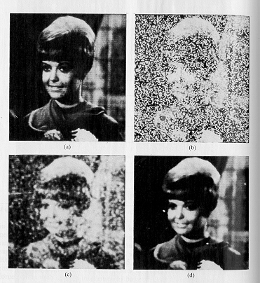
Smoothing Filters (Non-Linear) (Median)
Very effective for removing “salt and pepper” noise (i.e., random occurrences of black and white pixels).
*
CUI, Lahore Campus -- CSC 331: Digital Image Processing -- © Dr. Usama Ijaz Bajwa

Slide 8
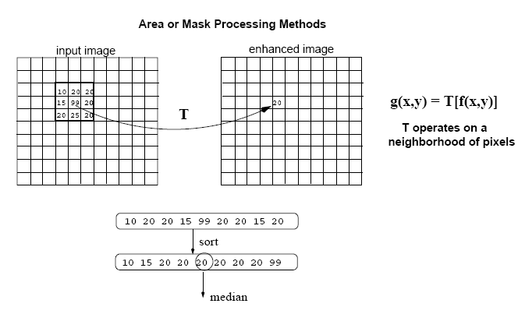
Smoothing Filters (Non-Linear) (Median)
Replace each pixel by the median in a neighborhood around the pixel
*
CUI, Lahore Campus -- CSC 331: Digital Image Processing -- © Dr. Usama Ijaz Bajwa

Slide 9

Median Filtering (example)
CUI, Lahore Campus -- CSC 331: Digital Image Processing -- © Dr. Usama Ijaz Bajwa

Slide 10
Spatial filtering for image sharpening
Background: To highlight fine detail in an image or to enhance blurred detail
Applications: Electronic printing, medical imaging, industrial inspection, autonomous target detection (smart weapons)......
Foundation:
Blurring/smoothing is performed by spatial averaging (equivalent to integration)
Sharpening is performed by noting only the gray level changes in the image that is the differentiation
CUI, Lahore Campus -- CSC 331: Digital Image Processing -- © Dr. Usama Ijaz Bajwa

Slide 11
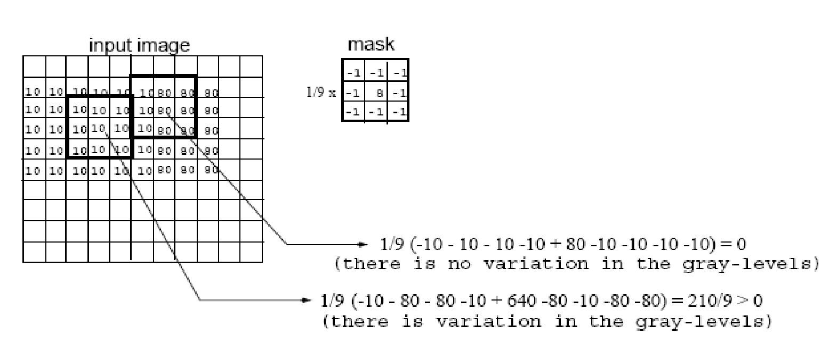
Sharpening Filters (High Pass filtering)
Useful for emphasizing transitions in image intensity (e.g., edges).
*
CUI, Lahore Campus -- CSC 331: Digital Image Processing -- © Dr. Usama Ijaz Bajwa

Slide 12
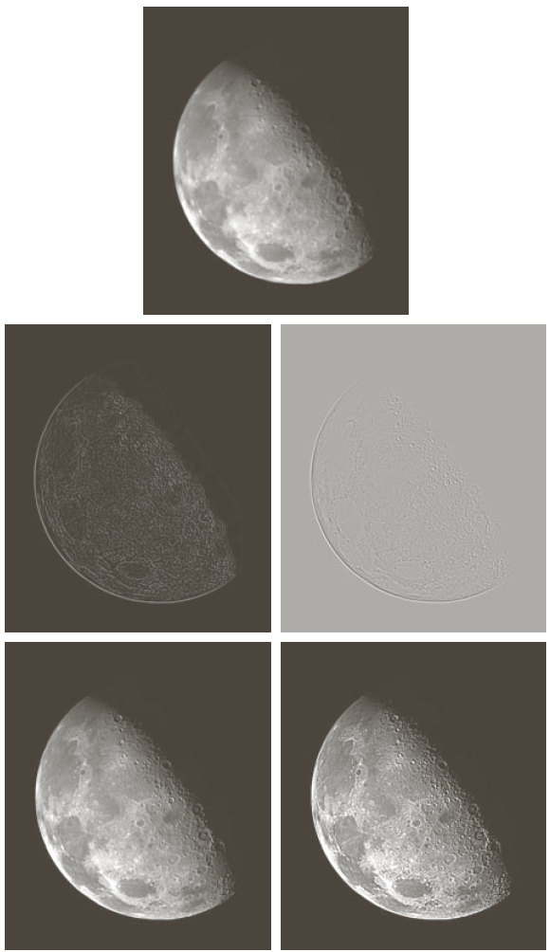
Sharpening Filters (High Pass filtering)
Note that the response of high-pass filtering might be negative.
Values must be re-mapped to [0, 255]
original image
sharpened images
*
CUI, Lahore Campus -- CSC 331: Digital Image Processing -- © Dr. Usama Ijaz Bajwa

Slide 13
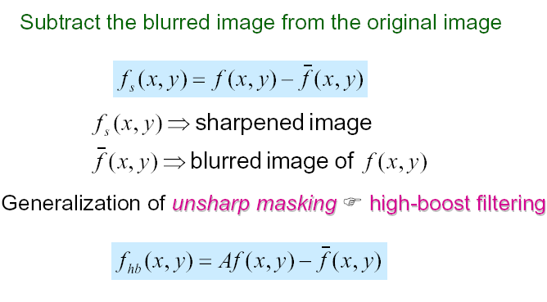



Sharpening Filters: Unsharp Masking
Obtain a sharp image by subtracting a lowpass filtered (i.e., smoothed) image from the original image:
-
=
CUI, Lahore Campus -- CSC 331: Digital Image Processing -- © Dr. Usama Ijaz Bajwa

Slide 14
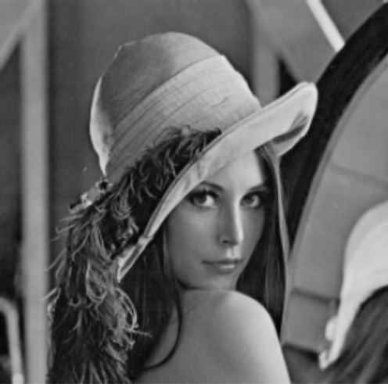

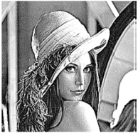

Sharpening Filters: Unsharp Masking (cont’d)
If A=1, we get a high pass filter
If A>1, part of the original image is added back to the high pass filtered image.
A=1.4
A=1.9
CUI, Lahore Campus -- CSC 331: Digital Image Processing -- © Dr. Usama Ijaz Bajwa

Slide 15
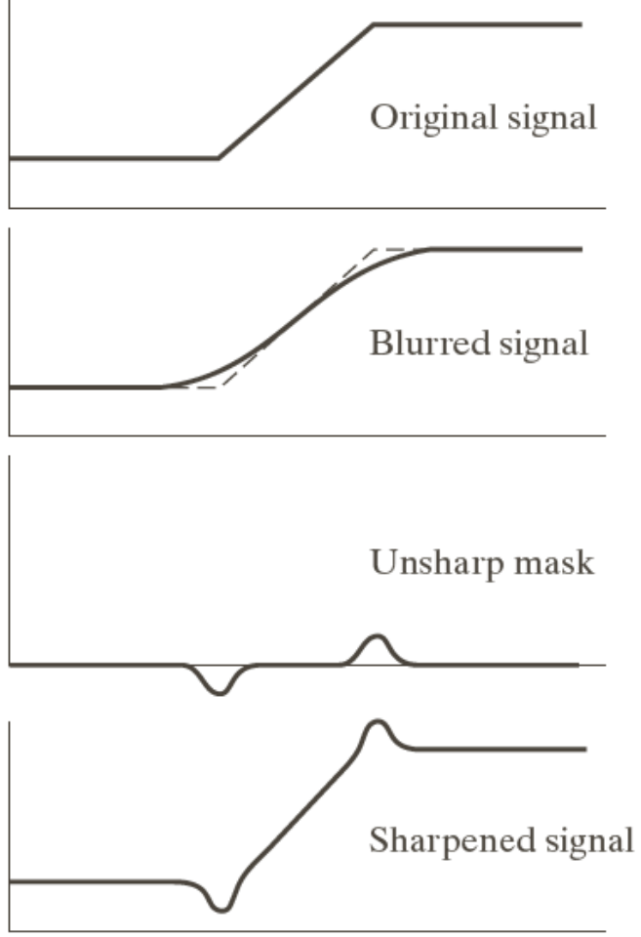
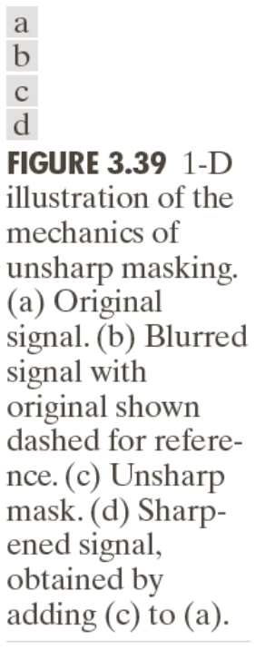
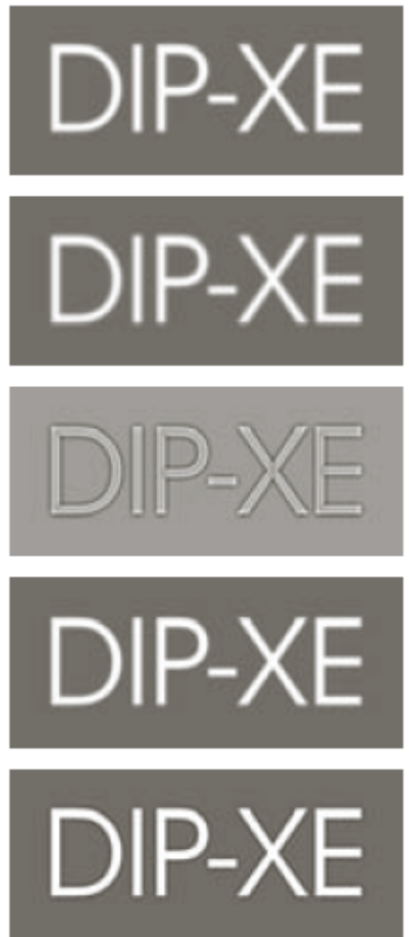
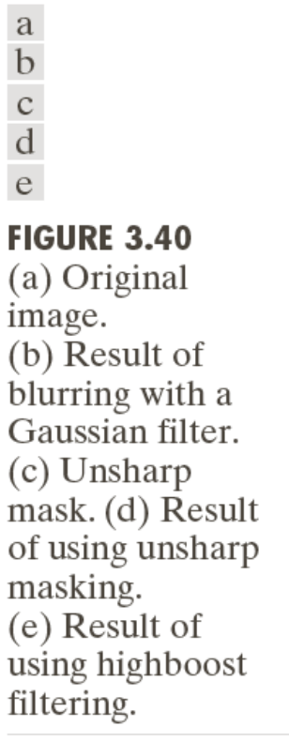
Unsharp Masking (cont’d)
CUI, Lahore Campus -- CSC 331: Digital Image Processing -- © Dr. Usama Ijaz Bajwa

Slide 16
Spatial filtering for image sharpening
Operation of Image Differentiation
Enhance edges and discontinuities
De-emphasize areas with slowly varying gray-level values
Mathematical Basis of Filtering for Image Sharpening
Implementation by mask filtering
First-order and second-order derivatives
CUI, Lahore Campus -- CSC 331: Digital Image Processing -- © Dr. Usama Ijaz Bajwa

Slide 17
Image sharpening (High-Pass Filters)
Spatial filters whose effect on the output image is equivalent to preserving or emphasizing its high-frequency components (e.g., fine details, points, lines, and edges), i.e. to highlight transitions in intensity within the image.
Linear HPFs can be implemented using 2D masks with positive and negative weights / coefficients, (Laplacian, a simple, isotropic (i.e., rotation invariant) second-order derivative)
CUI, Lahore Campus -- CSC 331: Digital Image Processing -- © Dr. Usama Ijaz Bajwa

Slide 18
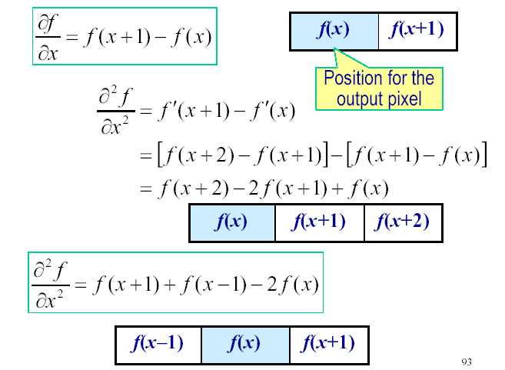
First-order and second-order derivatives
CUI, Lahore Campus -- CSC 331: Digital Image Processing -- © Dr. Usama Ijaz Bajwa

Slide 19
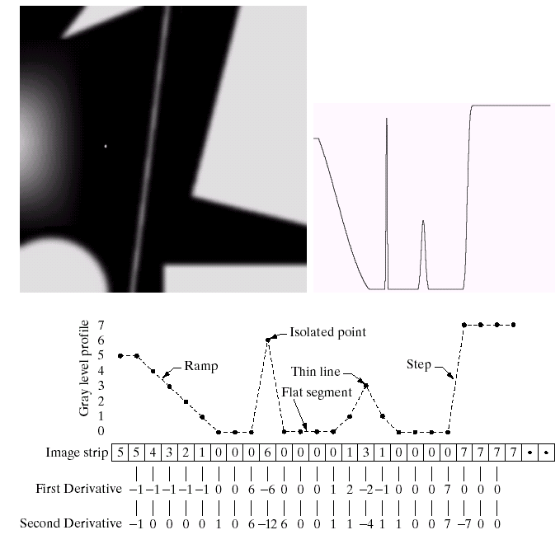
Example for discrete derivatives
CUI, Lahore Campus -- CSC 331: Digital Image Processing -- © Dr. Usama Ijaz Bajwa

Slide 20
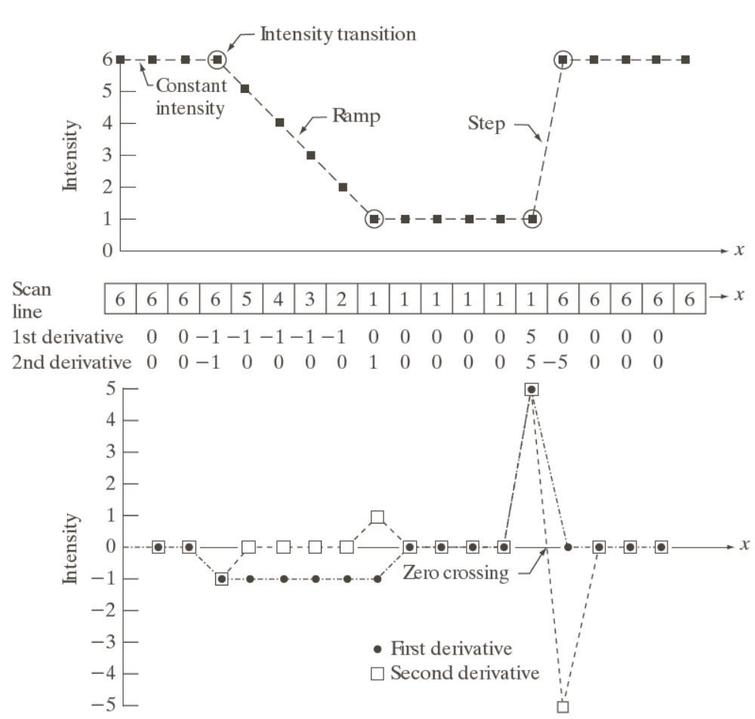
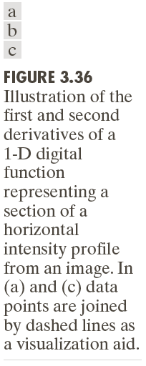
Example for discrete derivatives
CUI, Lahore Campus -- CSC 331: Digital Image Processing -- © Dr. Usama Ijaz Bajwa

Slide 21
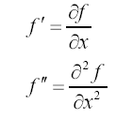
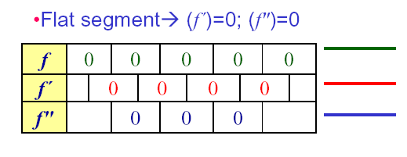
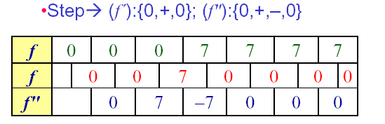
Various situations encountered for derivatives
CUI, Lahore Campus -- CSC 331: Digital Image Processing -- © Dr. Usama Ijaz Bajwa

Slide 22
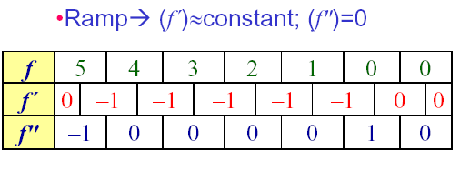
Various situations encountered for derivatives
Ramps or steps in the 1D profile normally characterize the edges in an image
f ″ is nonzero at the onset and end of the ramp:
produces thin (double) edges
f ′ is nonzero along the entire ramp: produces thick edges
CUI, Lahore Campus -- CSC 331: Digital Image Processing -- © Dr. Usama Ijaz Bajwa

Slide 23
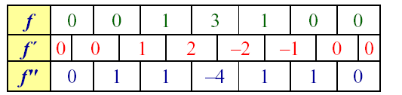
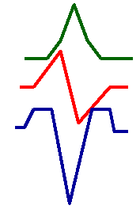
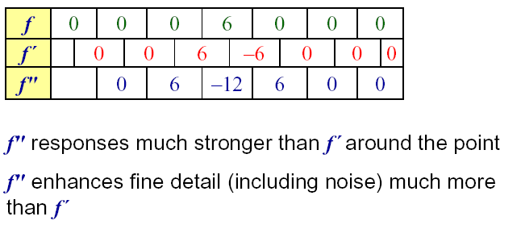
Various situations encountered for derivatives
Thin lines
Isolated point
CUI, Lahore Campus -- CSC 331: Digital Image Processing -- © Dr. Usama Ijaz Bajwa

Slide 24
Comparison between f" and f´
f´ generally produce thicker edges in an image
f" have a stronger response to fine detail
f´ generally have a stronger response to a gray-level step
f" produces double response at step changes in gray level
f" responses given similar changes in gray-level values
point > step > line
For image enhancement, f" is generally better suited than f´
Major application of f´ is for edge extraction;
f´ used together with f" results in impressive enhancement effect
CUI, Lahore Campus -- CSC 331: Digital Image Processing -- © Dr. Usama Ijaz Bajwa

